Slide 1
Operating Systems
Memory Management (3)
Fagui Liu
<number>/73

Slide 2
Content of the Lecture
Review
Design Issues for paging systems
Implementation Issues
Segmentation
Summary
<number>/73

Slide 3
Virtual Memory
Provide user with virtual memory that is as big as user needs
Store virtual memory on disk
Cache parts of virtual memory being used in real memory
Load and store cached virtual memory without user program intervention(加载和存储缓存的虚拟内存，无需用户程序干预)
基本思想:每个程序拥有自己的地址空间,这个空间被分割成多个块,每个块称为一页或页面(page).每个页有连续的地址范围……..
虚拟内存的实现：将虚拟地址空间分解成页，并将每一页映射到内存的某个页框或者（暂时）解除映射。）

Slide 4
Structure of Page Table Entry
高速缓冲
禁止位(禁止该页面被高速缓存）
修改位（或脏位）
“在/不在”位（存在位）
页框号
保护位
访问位
Figure 3-11. A typical page table entry

Slide 5
Page Mapping Example
Virtual Memory Address (P,D)
Page Table
004
006
Associative Look Up
0
1
12
4
1
7
4
6
9
0
First
19
3
004-> 009
1
3
7
1
0
Table organized by
LRU
1
009
006
Physical Address (F,D)
<number>/73
Notes:
First access, retrieve page from page table

Slide 6
Page Mapping Example: next reference
Virtual Memory Address (P,D)
Page Table
004
006
Associative Look Up
0
1
12
4
1
4
9
0
First
19
3
004-> 009
1
3
7
1
0
Table organized by
LRU
1
009
006
Physical Address (F,D)
<number>/73
Notes:
Second access, retrieve page from associative registers.

Slide 7

Multilevel Page Tables
(b)
Figure 3-13. (a) A 32-bit address with two page table fields.
(b) Two-level page tables.

Slide 8
Inverted Page Tables
Main idea
  One PTE for each physical page frame
  Hash (Vpage, pid) to Ppage#
Pros
  Small page table for large address space
Cons
  Lookup is difficult
  Overhead of managing hash chains, etc
Physical
address
Virtual
address
pid
vpage
offset
k
offset
0
pid
vpage
k
n-1
Inverted page table
<number>/73

Slide 9
Inverted Page Table
Virtual Address (004006)
Page Table
004
006
0
1
5
0
1
4
1
0
1
005
006
Physical Address (005006)
<number>/73

Slide 10
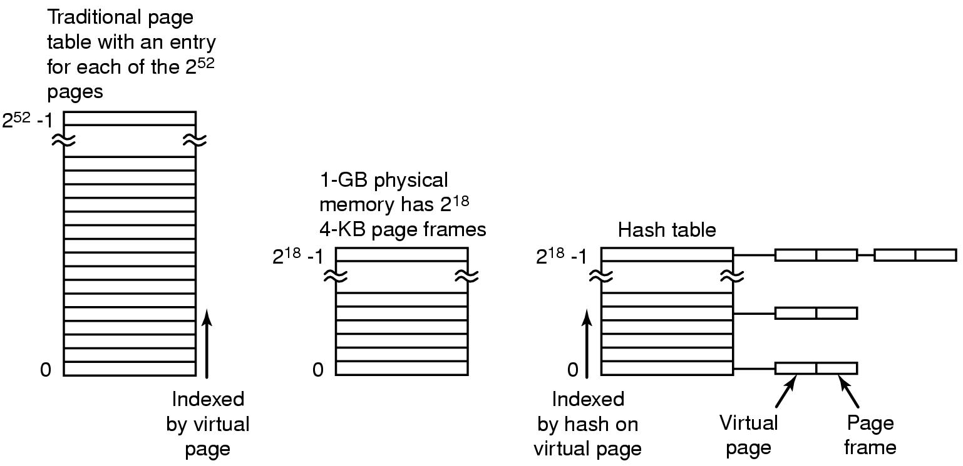
Inverted Page Tables
Figure 3-14. Comparison of a traditional page table
with an inverted page table.

Slide 11
Paging Policies
Fetch Strategies
  When should a page be brought into primary (main) memory from secondary (disk) storage.
Placement Strategies
  When a page is brought into primary storage, where is it to be put?
Replacement Strategies
  Which page now in primary storage is to be removed from primary storage when some other page or segment is to be brought in and there is not enough room.
<number>/73

Slide 12
Demand Paging
Algorithm Never bring a page into primary memory until its needed.
  Page fault
  Check if a valid virtual memory address. Kill job if not.
  If valid reference, check if its cached in memory already (perhaps for some other process.) If so, skip to 7).
  Find a free page frame.
  Map address into disk block and fetch disk block into page frame. Suspend user process.
  When disk read finished, add vm mapping for page frame.
  If necessary, restart process.
<number>/73

Slide 13




Page Replacement
Find location of page on disk
Find a free page frame
  If free page frame use it
  Otherwise, select a page frame using the page replacement algorithm
  Write the selected page to the disk and update any necessary tables
Read the requested page from the disk.
Restart the user process.
It is necessary to be careful of synchronization problems. For example, page faults may occur for pages being paged out.
<number>/73

Slide 14
Page Replacement Strategies
The Principle of Optimality
  Replace the page that will not be used again the farthest time in the future.
NRU - Not Recently Used （NRU最近未使用算法）
  An approximation to LRU.
FIFO - First in First Out
  Replace the page that has been in primary memory the longest
Second Chance----pages are kept in FIFO order using a link list
Clock----pages are kept in FIFO order using a circular list
LRU - Least Recently Used （LRU最近最少使用）
  Replace the page that has not been used for the longest time
LFU - Least Frequently Used （LFU最少使用）
  Replace the page that is used least often
Working Set
  Keep in memory those pages that the process is actively using.
WSClock
<number>/73

Slide 15
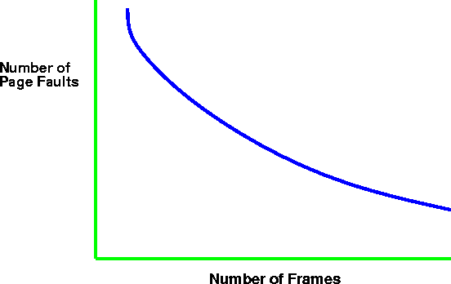
Paging Behavior with Increasing
Number of Page Frames
<number>/73

Slide 16
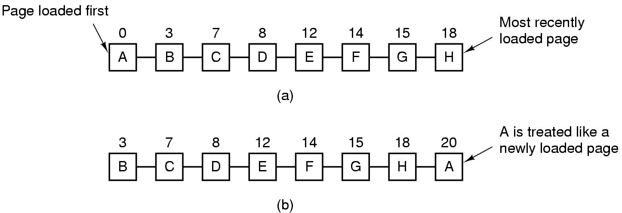
Second Chance Algorithm
Figure 3-15. Operation of second chance.
(a) Pages sorted in FIFO order.
(b) Page list if a page fault occurs at time 20 and A has its R bit set. The numbers above the pages are their load times.

Slide 17
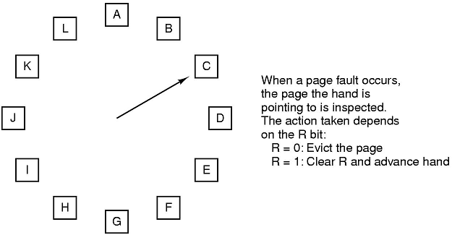
The Clock Page Replacement Algorithm
Figure 3-16. The clock page replacement algorithm.

Slide 18
NFU: A LRU Approximation（用软件模拟）
NFU: Evict a page that is NOT Frequently used（最不常用）;
LRU: evict a page that is LEAST recently used（最近最少使用）;
NFU Implementation: simpler than LRU
  additional reference bits
  a register is kept per page
  a one bit is set in the register if the page is referenced
  the register is shifted by one after some time interval(右移)
  00110011 would be accessed more recently than 00010111
  the page with register holding the lowest number is the least recently used.
  the value may not be unique. use FIFO to resolve conflicts.
<number>/73

Slide 19
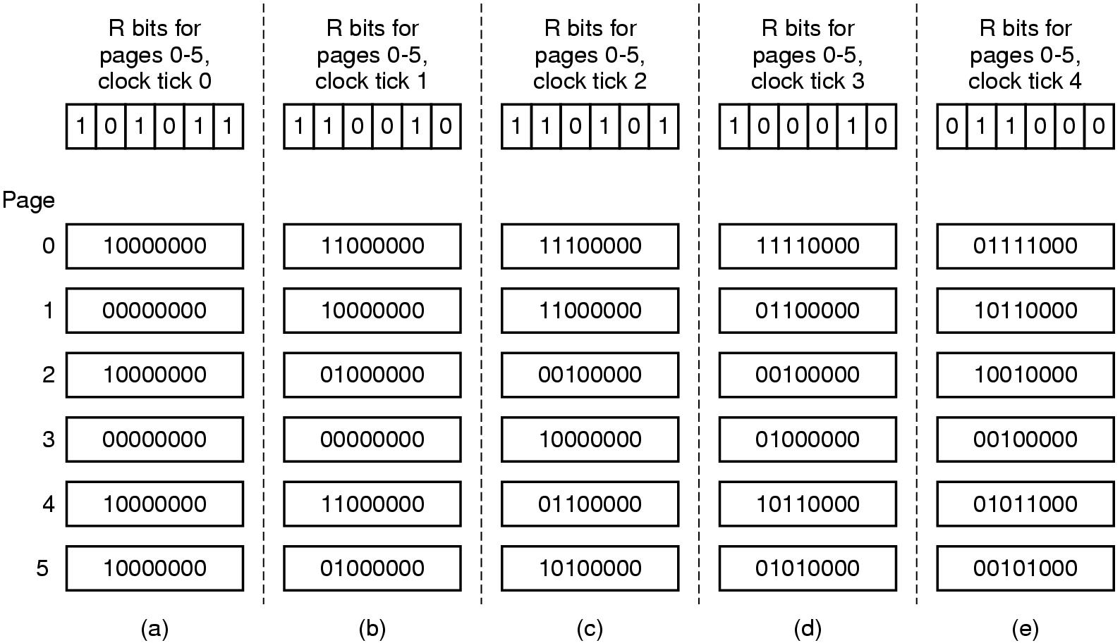
Simulating LRU in Software
Figure 3-18. The aging algorithm（老化算法） simulates LRU in software. Shown are six pages for five clock ticks. The five clock ticks are represented by (a) to (e).

Slide 20
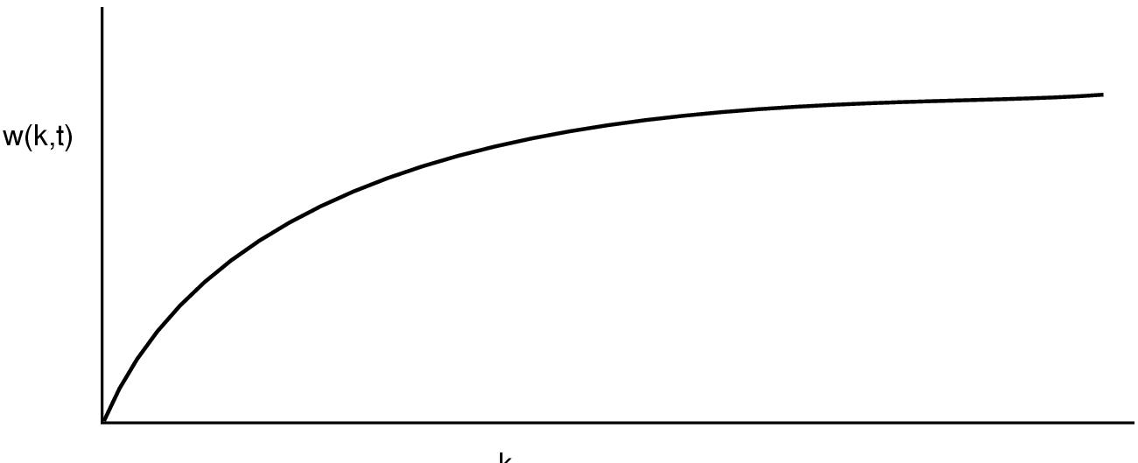
The Working Set Page Replacement Algorithm (1)
k
The working set is the set of pages used by the k most recent memory references(工作集是在最近K次内存访问所有过的页面的集合)
w(k,t) is the size of the working set at time, t(函数w(k,t) 是在时刻t 的工作集的大小)
<number>/73

Slide 21
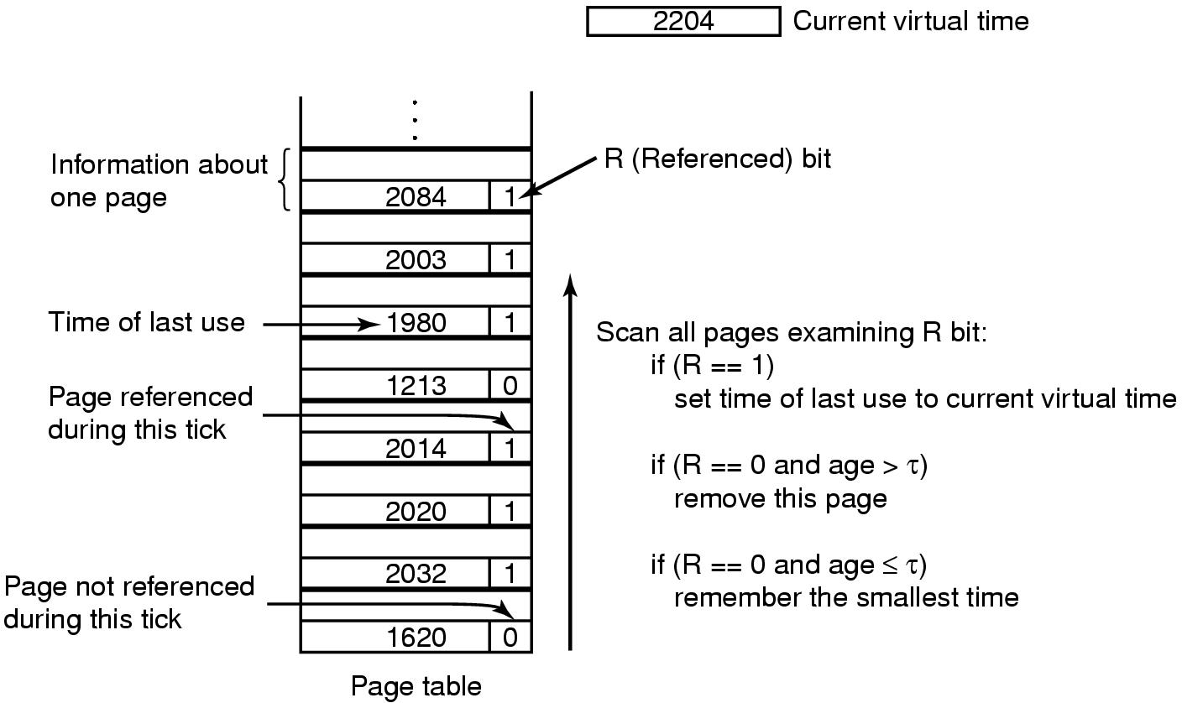


The Working Set Page Replacement Algorithm (2)
Age(生存时间)=Current virtual time(当前实际时间)-Time of last use(上次使用时间)
Smallest time(最小时间)为min {Time of last use}上次使用时间的最小值
<number>/73

Slide 22
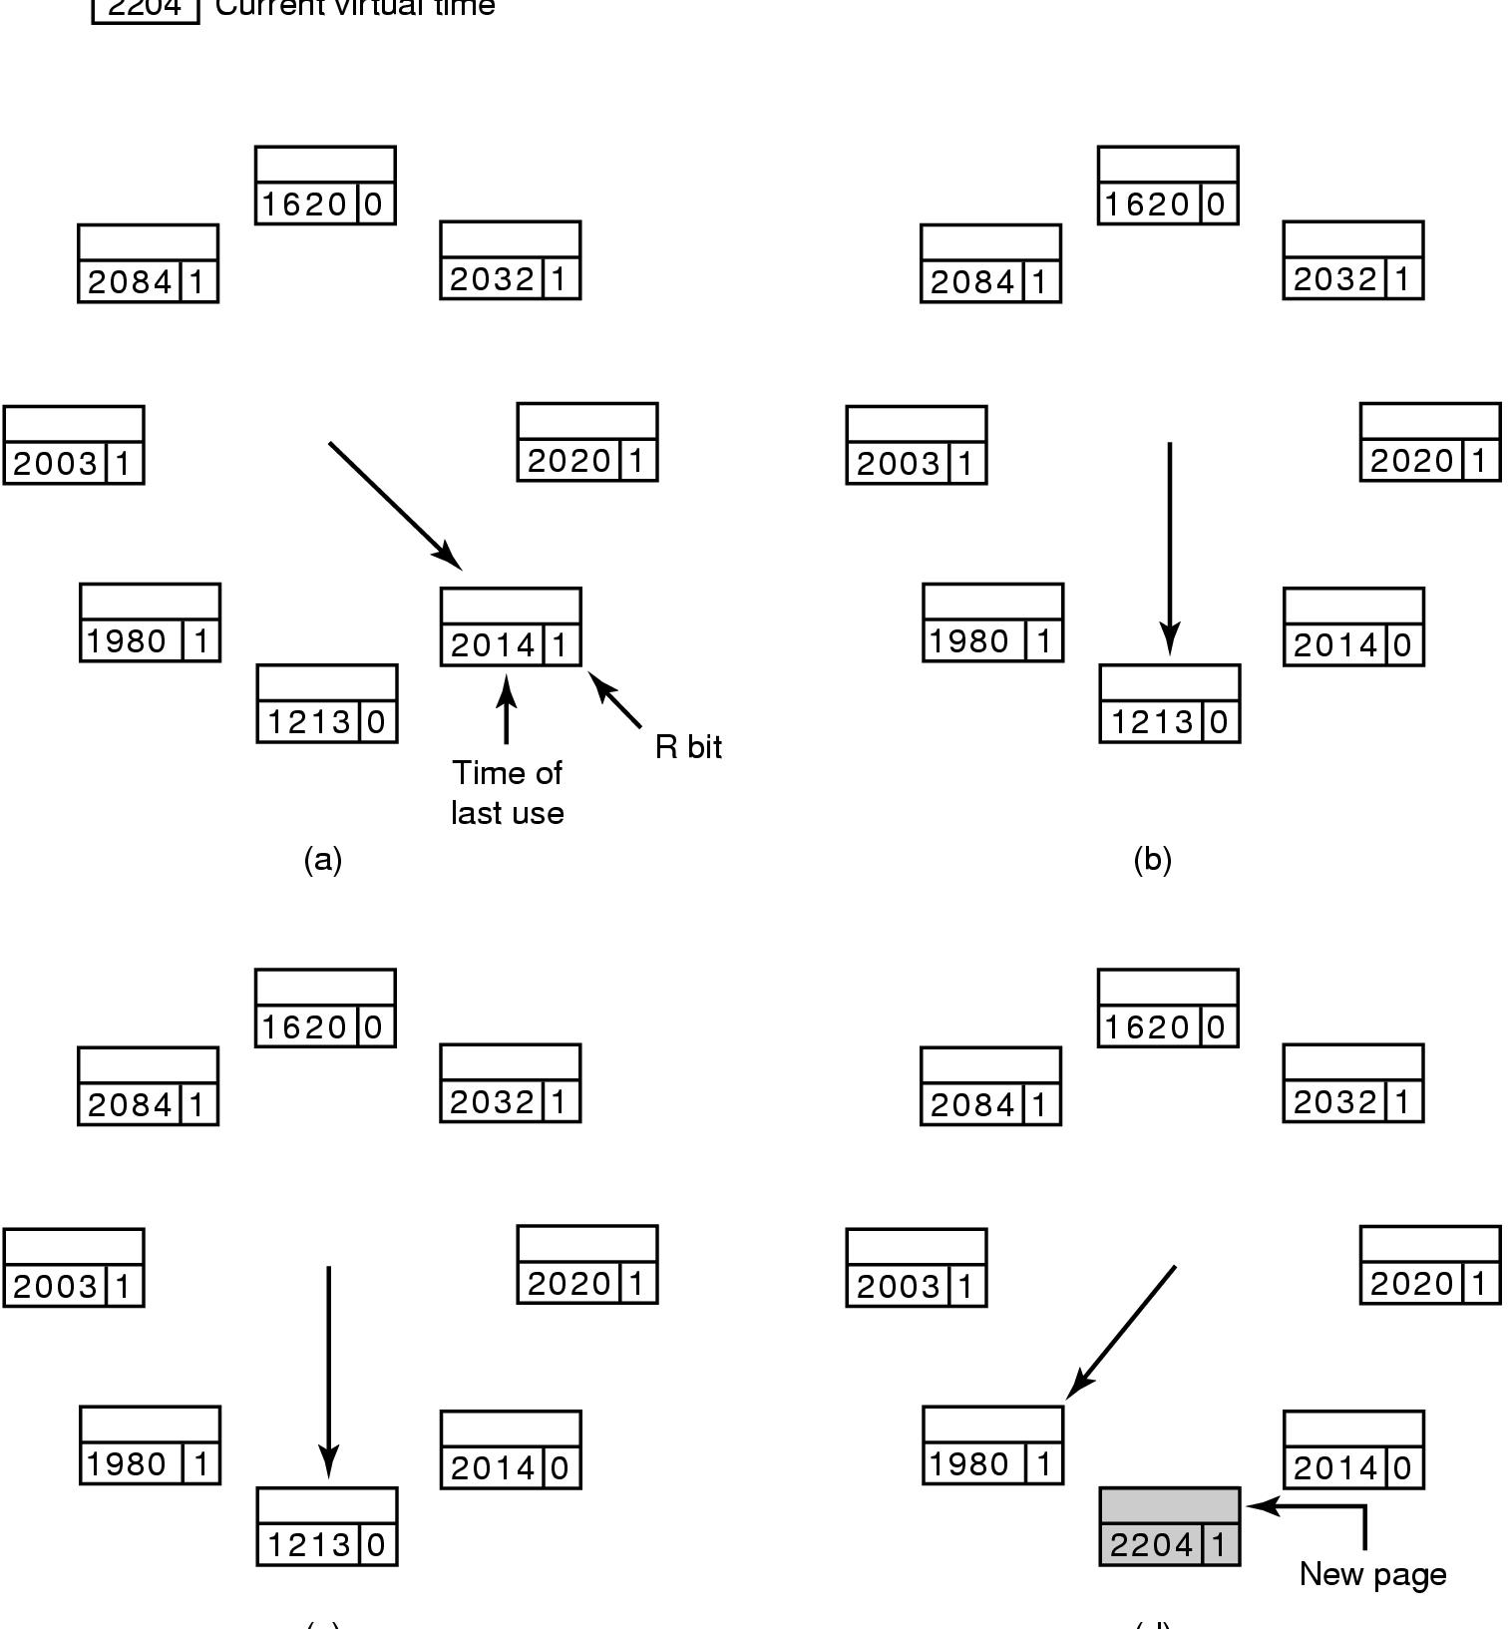
The WSClock Page Replacement Algorithm（工作集时钟页面置换算法）
Figure 3-21. Operation of the WSClock algorithm.
(c) and (d) give an example of R = 0.
<number>/73

Slide 23
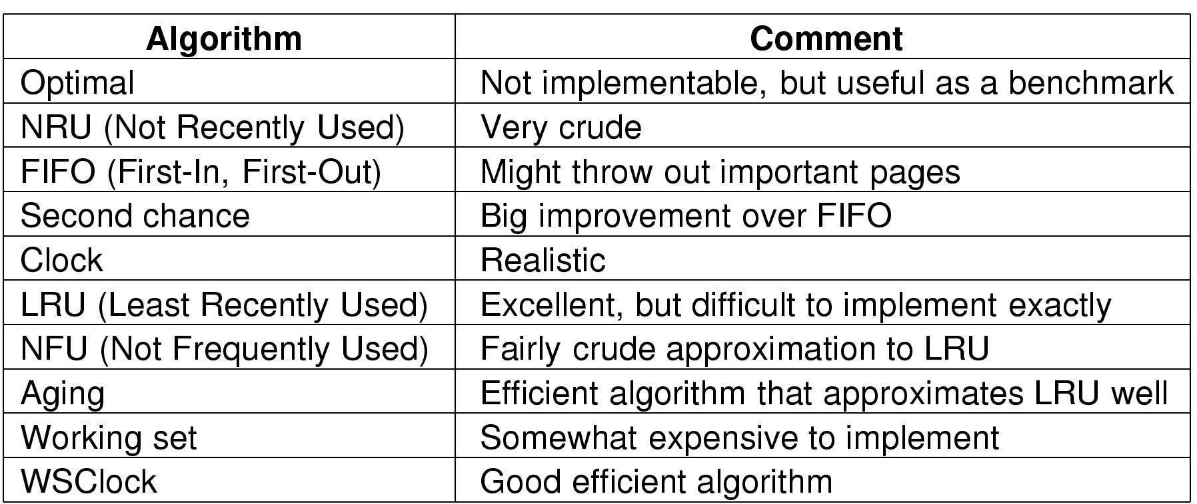
Review of Page Replacement Algorithms
最优算法
最近未使用算法
先进先出算法
第二次机会算法
时钟算法
最近最少使用算法
最不经常使用算法
老化算法
工作集算法
工作集时钟算法
<number>/73

Slide 24
Content of the Lecture
Review
Design Issues for paging systems
Implementation Issues
Segmentation
Summary
<number>/60

Slide 25
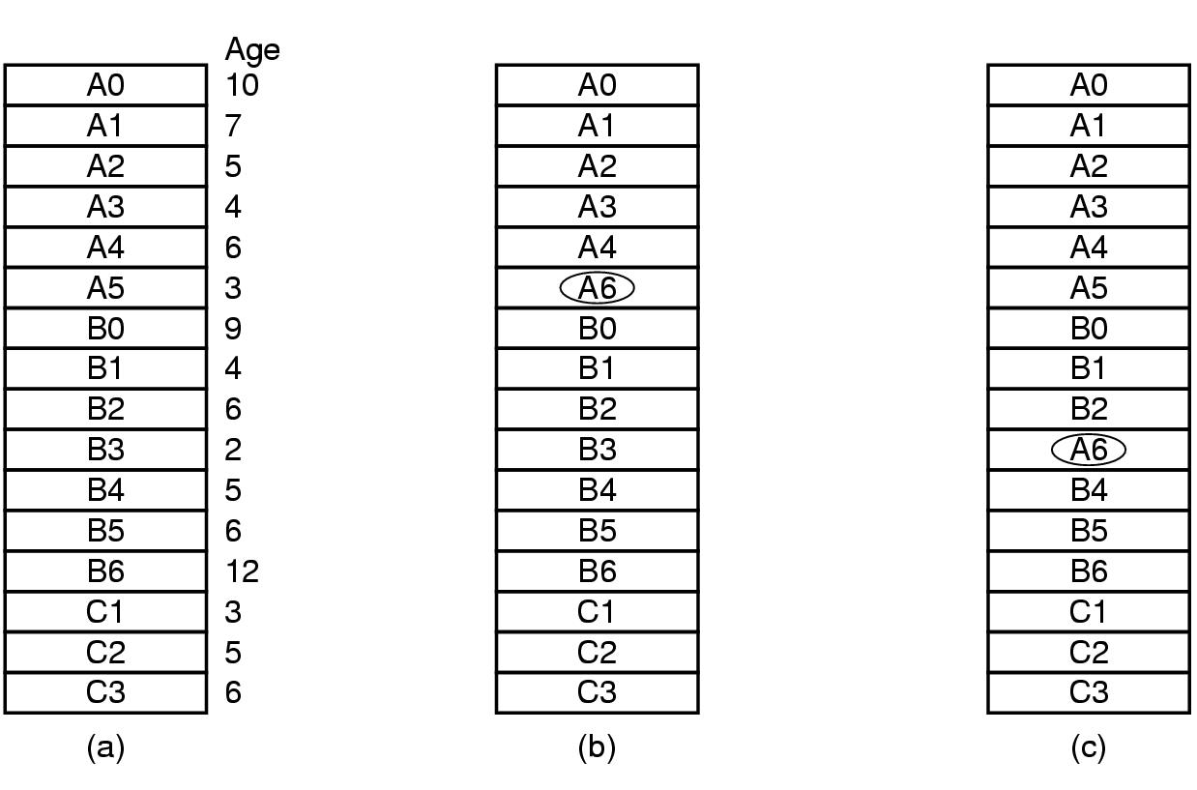
Design Issues for Paging Systems
Local versus Global Allocation Policies (1)
全局算法在通常情况下工作得比局部算法好！
(a)Original configuration：如果进程A发生缺页中断
(b)Local page replacement
(c) Global page replacement
Spring 2003
<number>/73

Slide 26
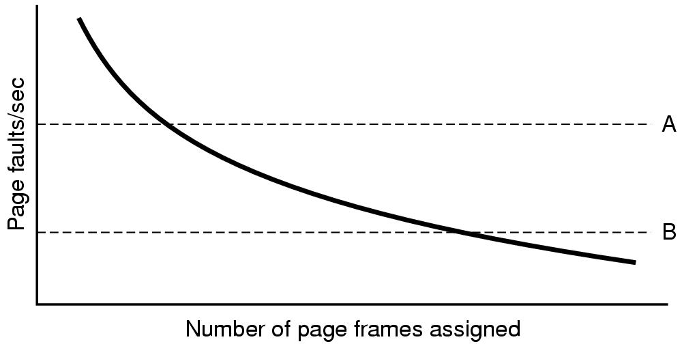
Local versus Global Allocation Policies (2)
Page fault rate as a function of the number of page frames assigned
B< Page fault rate <A
虚线A对应一个高得不可接受的缺页中断率，虚线B则对应于一个低得可以假设进程拥有过多内存的缺页率。此时可能会从该进程的资源中剥夺部分页框。这样PFF (Page Fault Frequency)尽力让每个进程的缺页中断率控制在可接受的范围内。
<number>/73

Slide 27
Load Control
Despite good designs, system may still thrash(颠簸)
When PFF (Page Fault Frequency ) algorithm indicates
  some processes need more memory
  but no processes need less
Solution :
Reduce number of processes competing for memory
  swap one or more to disk, divide up pages they held
  reconsider degree of multiprogramming
<number>/60

Slide 28
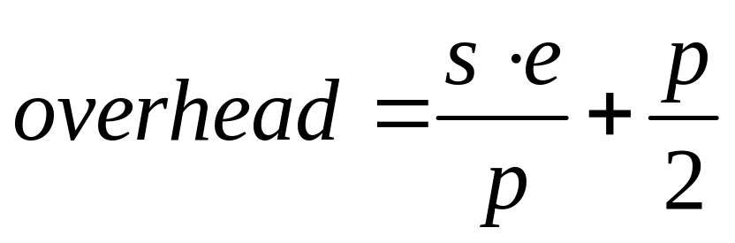
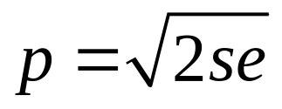
Page Size
Overhead due to page table and internal fragmentation
Where
  s = average process size in bytes(进程的平均大小s字节)
  p = page size in bytes(页大小为p字节)
  e = page entry(每个页表需要e字节)
page table space
internal fragmentation
Optimized when
<number>/66

Slide 29
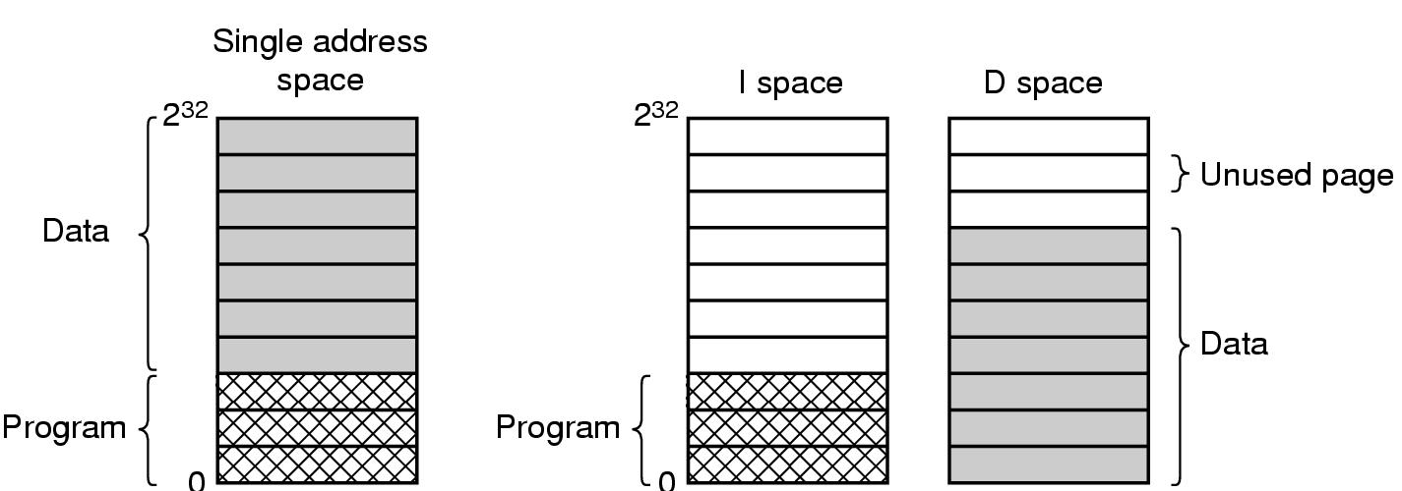
Separate Instruction and Data Spaces
Figure 3-25.
(a) One address space. （如果地址空间足够大时,可用）
(b) Separate I and D spaces(（如果地址空间小时，使用可使地址空间翻倍））分成I空间与D空间，两种地址空间独立，都可进行分页，分别拥有自己的页表；当硬件取指令操作时，要使用I空间和I空间页表；对数据的访问通过D空间页表).

Slide 30
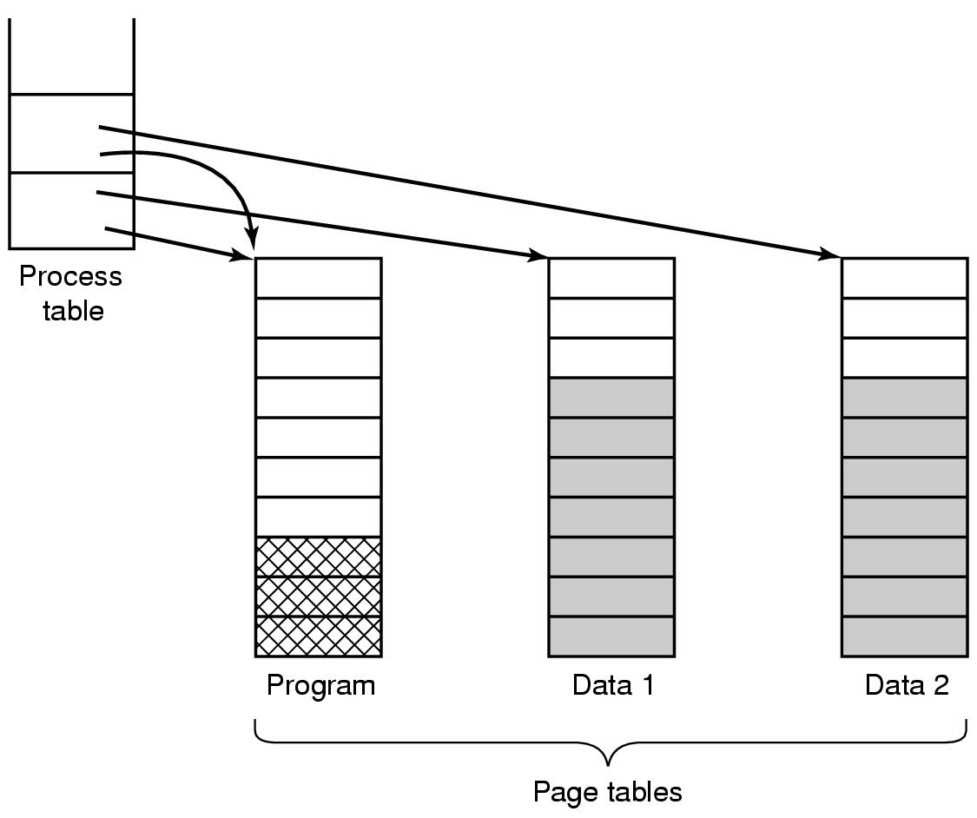
Shared Pages
Two processes sharing same program sharing its page table
（两个进程通过共享程序页表 来共享同一个程序）
<number>/73

Slide 31
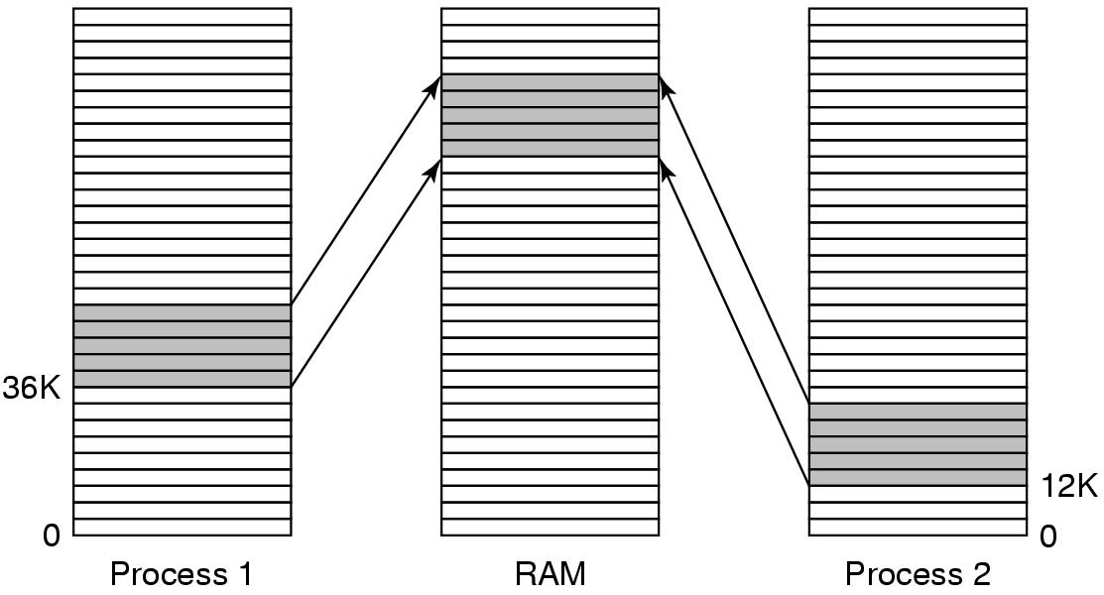
Shared Libraries
Figure 3-27. A shared library (如动态链接库DLL) being used by two processes.
当程序和共享库链接时，只加载一小段能够在运行时绑定被调用函数的存根例程（stub routine）（而非加载被调用函数）

Slide 32
Memory-mapped file(共享库实际上是一种更为通用的机制----内存映射文件的一个特例)
进程可以通过发起一个系统调用,将一个文件映射到其虚拟地址空间的一部分。
在多数实现中,在影射共享的页面时不会实际读入页面的内容,而是在访问页面时才会被每次一页地读入,磁盘文件则被当作后备存储.但进程退出或显式地解除文件映射时,所有被改动的页面会被写回文件中.
内存映射文件可以把一个文件当作一个内存中的大字符数组来访问。
如果两个或两个以上进程同时映射了同一文件，则可以通过共享内存来通信。

Slide 33
Cleaning Policy
Need for a background process, paging daemon
  periodically inspects state of memory
When too few frames are free
  selects pages to evict using a replacement algorithm
It can use same circular list (clock)
  as regular page replacement algorithm but with diff ptr (可以采用双指针时钟:前指针指向清除(写回磁盘，后指针指向置换页面 ）
<number>/73

Slide 34
Content of the Lecture
Review
Design Issues for paging systems
Implementation Issues
Segmentation
Summary

Slide 35
Implementation Issues—
Operating System Involvement with Paging
Four times when OS involved with paging(OS做与调页有关工作的四个时间)
Process creation
  determine program size
  create page table
Process execution
  MMU reset for new process(重置)
  TLB flushed(刷新)
Page fault time
  determine virtual address causing fault
  swap target page out, needed page in
Process termination time
  release page table, pages
<number>/73

Slide 36
Page Fault Handling
Hardware traps to kernel
General registers saved
OS determines which virtual page needed
OS checks validity of address, seeks page frame
If selected frame is dirty, write it to disk
OS brings schedules new page in from disk
Page tables updated
Faulting instruction backed up to when it began
Faulting process scheduled
Registers restored
Program continues
<number>/73
Notes:
Faulting instruction backed up to when it began
恢复发生缺页中断指令以前的状态，程序计数器指向该条指令。

Slide 37
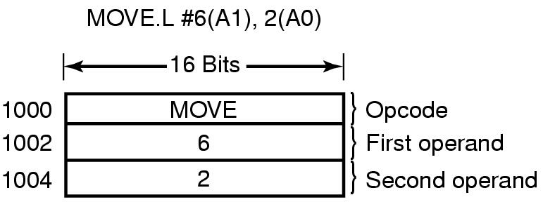
Instruction Backup
当程序访问不在内存中的页面是,将引起页面失效的指令半途停止并产生到OS的陷阱.下例从地址1000处开始的指令进行了3次内存访问(双地址指令），可能产生缺页中断
An instruction causing a page fault. That instruction is a example of Motorola that is used in embedded systems
CPU设计者解决方案:可用使用隐藏的内部寄存器复制程序计数器内容;
OS设计者解决方案:采用第二寄存器或找出所发生的问题来修复.
<number>/73

Slide 38
Locking Pages in Memory (pinning)
Virtual memory and I/O occasionally interact
Process issues call for read from device into buffer
  while waiting for I/O（e.g DMA）, another processes starts up
  has a page fault
  buffer for the first process may be chosen to be paged out
Need to specify some pages locked (Pinning)(或者在内核缓冲区中完成所有的I/O操作）
  exempted from being target pages
<number>/73

Slide 39
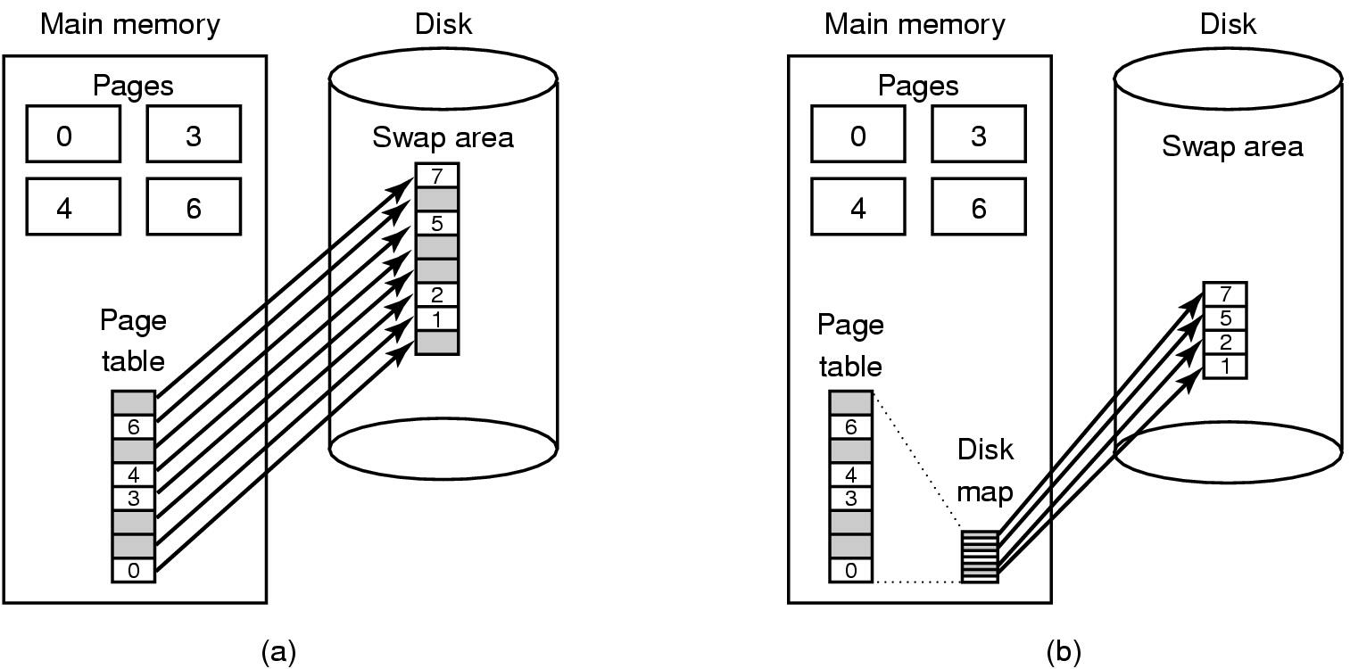
Backing Store（后备存贮）
--页被换出时的放置位置
(a) Paging to static swap area(静态：页面在磁盘上有固定的位置，磁盘的交换区与进程的虚拟空间一样大)
(b) Backing up pages dynamically(动态：页面在磁盘上无固定地址)
<number>/73

Slide 40
Separation of Policy and Mechanism (1)
策略从机制中分离----控制系统复杂度的方法
Memory management system is divided into
three parts:
A low-level MMU handler.
A page fault handler that is part of the kernel.
An external pager running in user space（外部页面调度程序）.

Slide 41
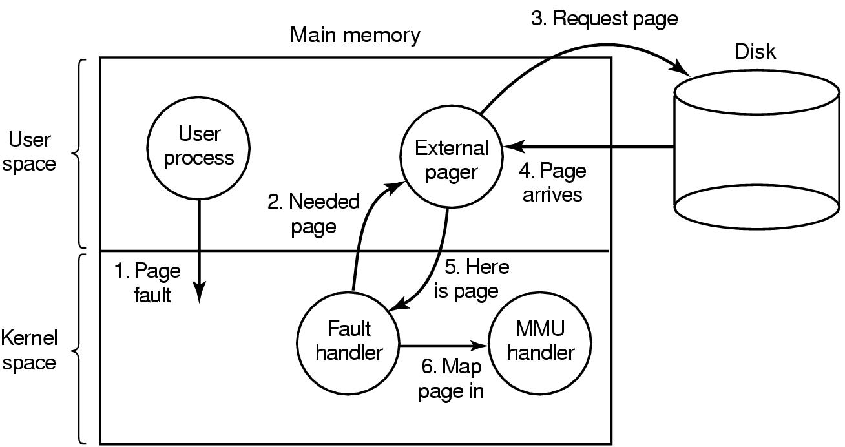
Separation of Policy and Mechanism
把策略从机制中分离出来(2)
机制
策略：Page fault handling with an external pager（用一个外部页面调度程序来处理缺页中断）
<number>/73

Slide 42
Content of the Lecture
Review
Design Issues for paging systems
Implementation Issues
Segmentation
Summary
<number>/73

Slide 43
Segmentation (1)
A compiler has many tables that are built up as compilation proceeds, possibly including(编译器在编译过程中会建立许多表,其中可能的的表格有):
The source text being saved for the printed listing (on batch systems).
The symbol table – the names and attributes of variables.
The table containing integer, floating-point constants used.
The parse tree(语法分析树), the syntactic analysis of the program.
The stack used for procedure calls within the compiler.
前4个表随着编译的进行不断增长，第5个表在编译过程中以一种不可预测的方式增长或缩小。

Slide 44

Segmentation (2)
One-dimensional address space with growing tables
One table may bump into another
<number>/73

Slide 45
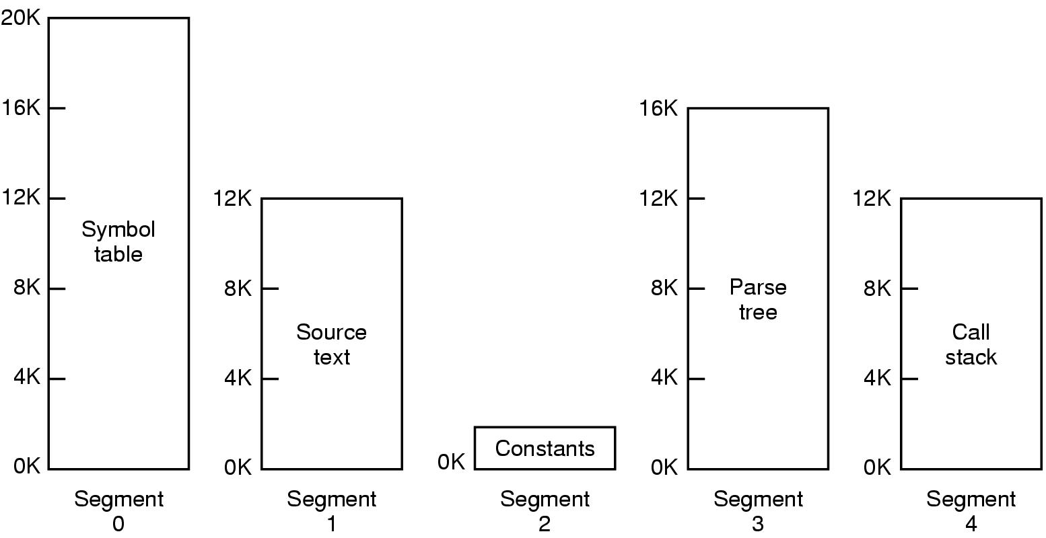
Segmentation (3)
Allows each table to grow or shrink, independently
<number>/73

Slide 46

Segmentation (4)
需要程序员了解该技术？
存在多少线性地址空间？
地址空间可超出物理存储器大小？
过程与数据被区分和保护？
其大小浮动的表易提供？
用户间过程方便？
为何引入该技术？
<number>/73
Comparison of paging and segmentation
Notes:
Fluctuate-变动, 波动, 涨落, 上下, 动摇
vt.使动摇, 使波动, 使起伏
accommodate
[ E5kCmEdeit ]
vt.供应, 供给, 使适应, 调节, 和解, 向...提供, 容纳, 调和
vi.适应

Slide 47
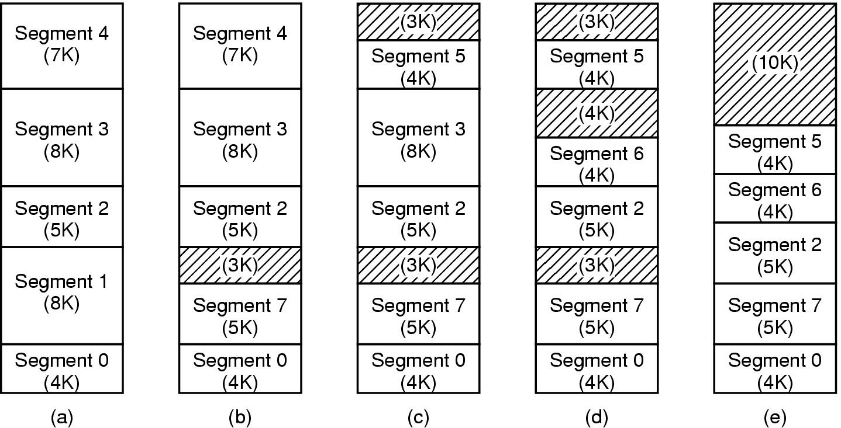
Implementation of Pure Segmentation
(a)-(d) Development of checkerboarding
(e) Removal of the checkerboarding by compaction
<number>/73
Notes:
SEG1out ,seg7 in

Slide 48
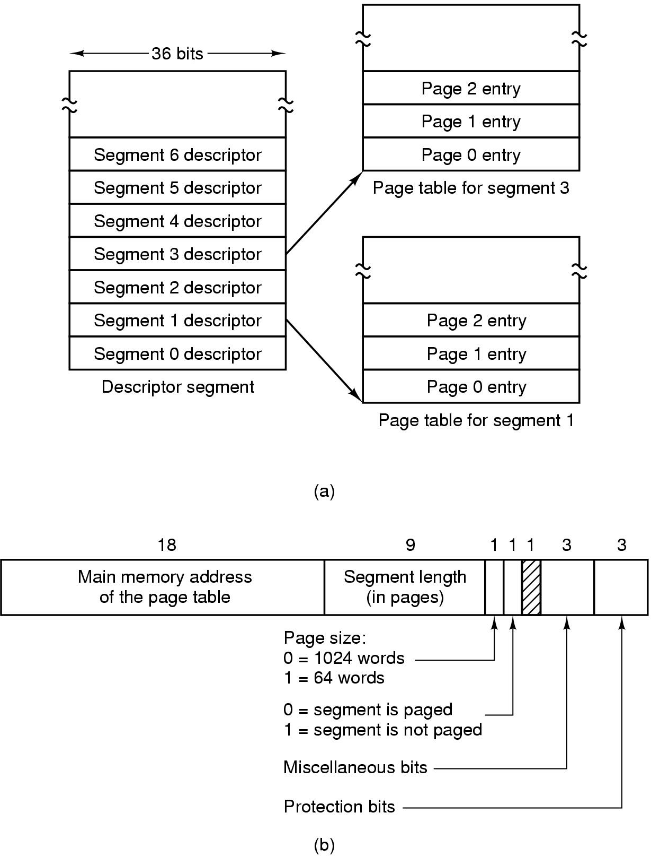
Segmentation with Paging: MULTICS (1)
Descriptor segment points to page tables
Segment descriptor – numbers are field lengths
<number>/73

Slide 49
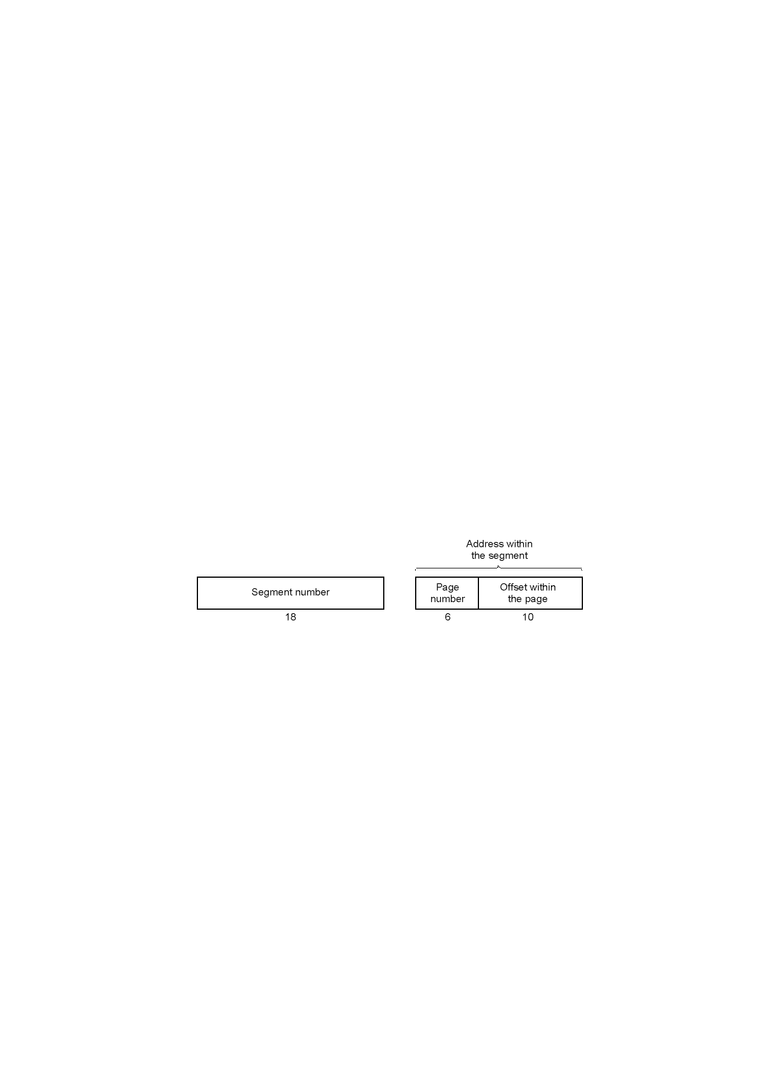
Segmentation with Paging: MULTICS (2)
A 34-bit MULTICS virtual address
<number>/73

Slide 50

Segmentation with Paging: MULTICS (3)
Figure 3-35. The MULTICS virtual memory. (b) A segment descriptor. The numbers are the field lengths.

Slide 51
Segmentation with Paging: MULTICS (6)
When a memory reference occurs, the following algorithm is carried out:
The segment number used to find segment descriptor.
Check is made to see if the segment’s page table is in memory.
  If not, segment fault occurs.
  If there is a protection violation, a fault (trap) occurs.
Page table entry for the requested virtual page examined.
  If the page itself is not in memory, a page fault is triggered.
  If it is in memory, the main memory address of the start of the page is extracted from the page table entry
The offset is added to the page origin to give the main memory address where the word is located.
The read or store finally takes place.

Slide 52
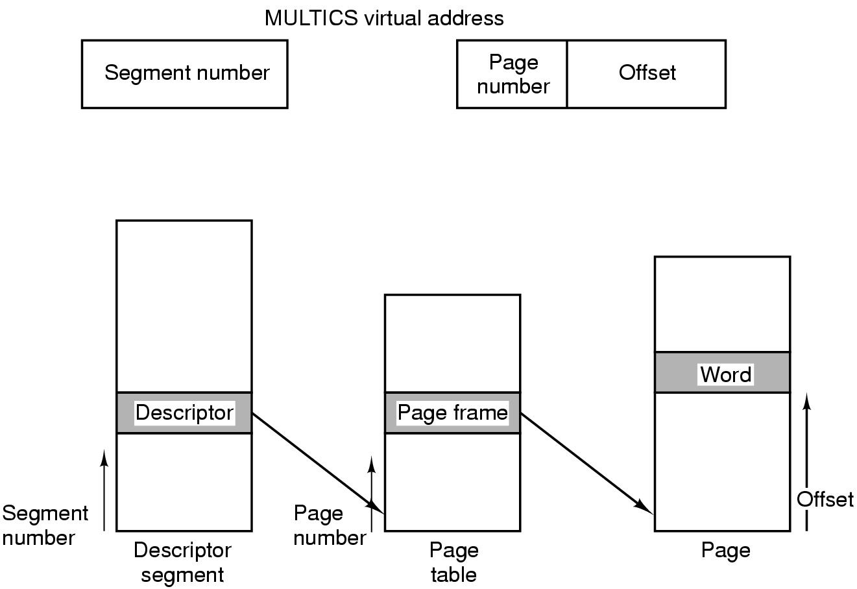
Segmentation with Paging: MULTICS (3)
Conversion of a 2-part MULTICS address into a main memory address
<number>/73

Slide 53
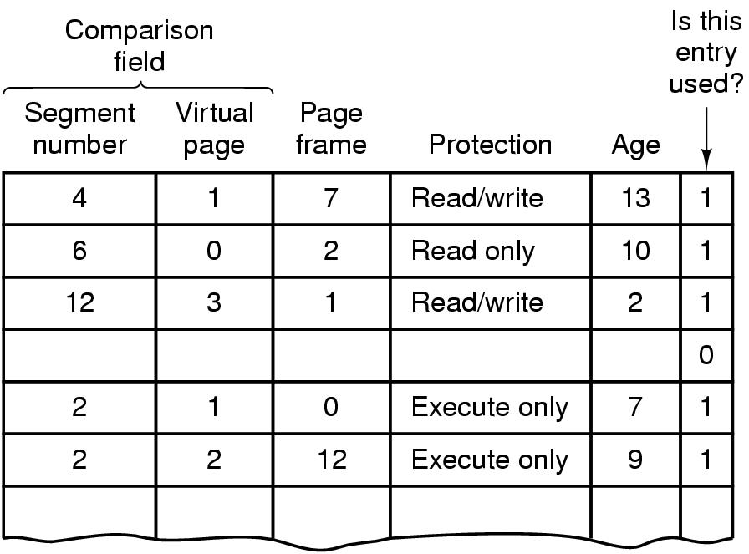
Segmentation with Paging: MULTICS (4)
Simplified version of the MULTICS TLB
Existence of 2 page sizes makes actual TLB more complicated
<number>/73
Notes:
页面大小有1024字节和64字两种.

Slide 54
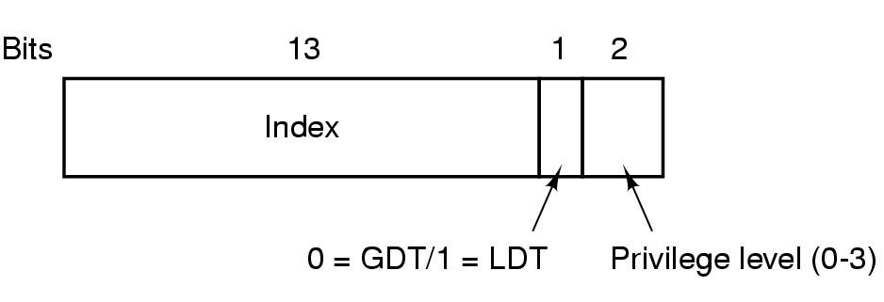
Segmentation with Paging: Pentium (1)
A Pentium selector
GDT( Global Descriptor Table), LDT (Local Descriptor Table)
1 表示段在局部的,在LDT中
X86处理器中的虚拟内存的核心是两张表：LDT（每个程序都有自己的LDT、所有程序共享一个GDT
<number>/73

Slide 55
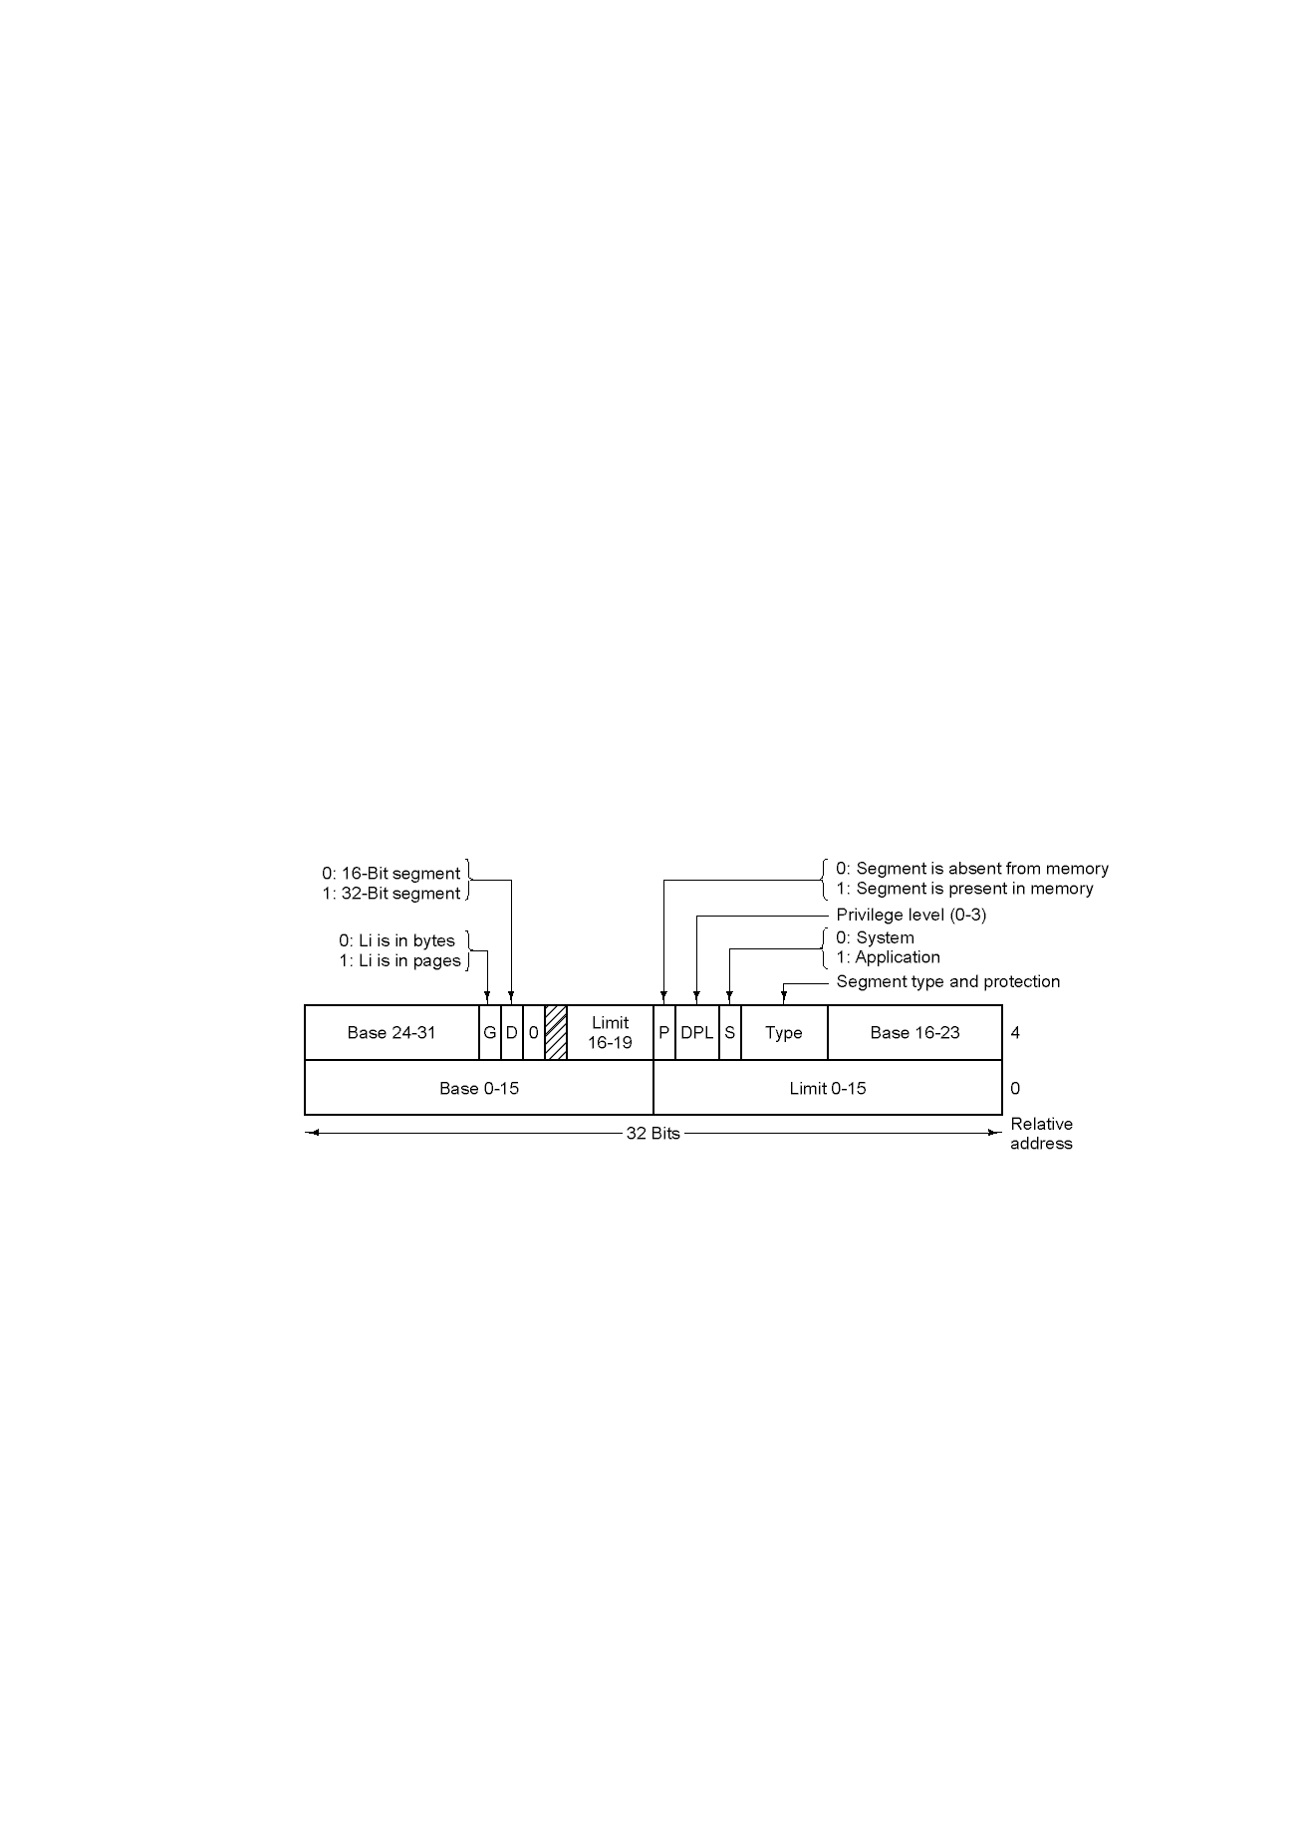
Segmentation with Paging: Pentium (2)
Pentium code segment descriptor（8个字节构成：段的基址、大小、其他信息）
Data segments differ slightly
<number>/60

Slide 56
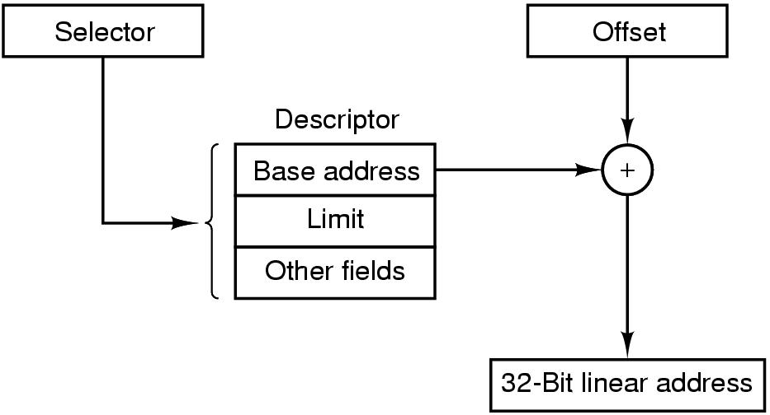
Segmentation with Paging: Pentium (3)
Conversion of a (selector, offset) pair to a linear address
<number>/73

Slide 57
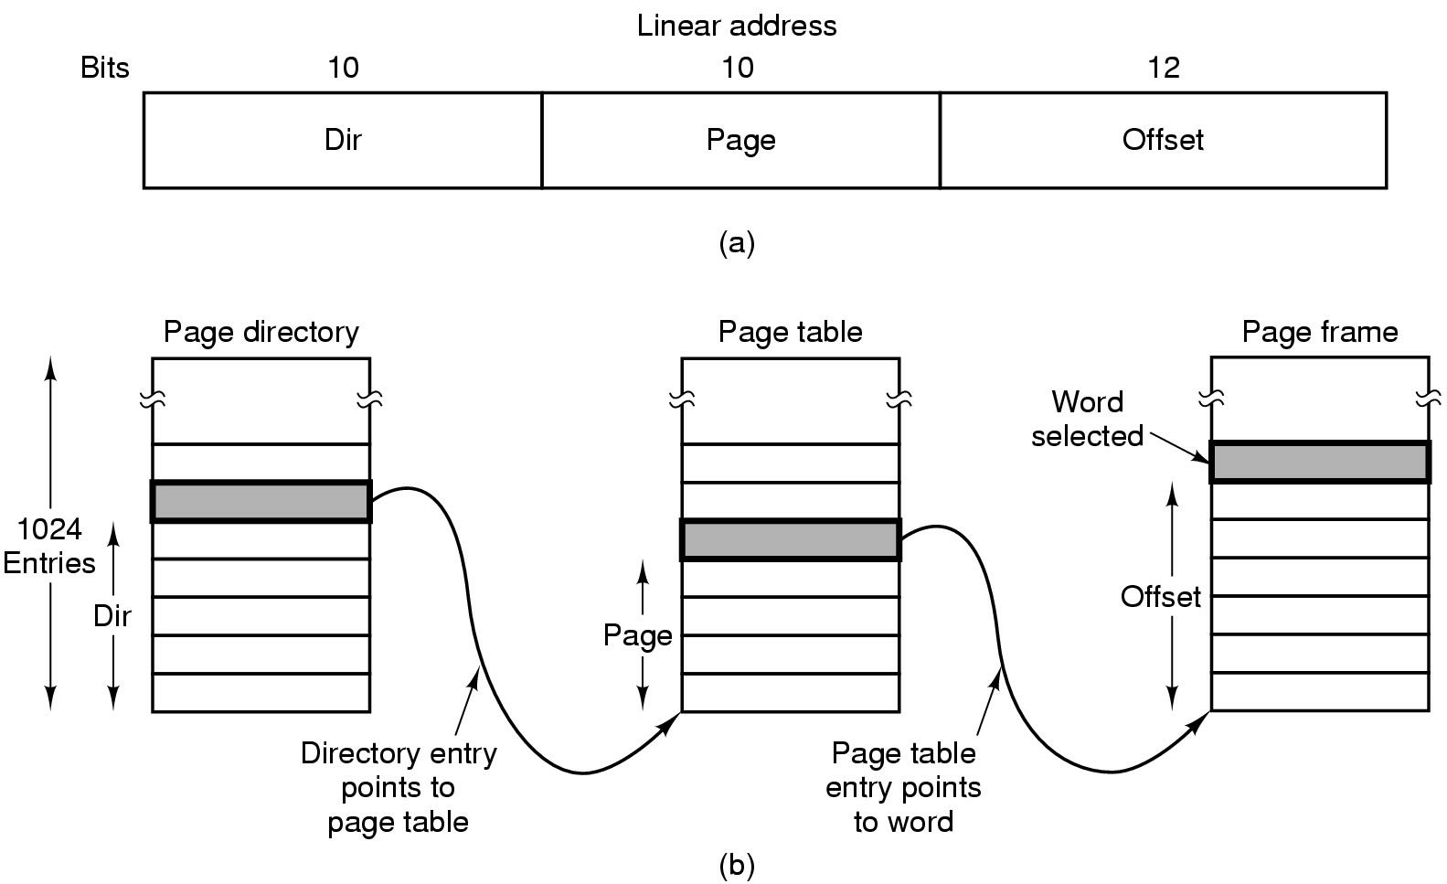
Segmentation with Paging: Pentium (4)
Mapping of a linear address onto a physical address
<number>/73

Slide 58
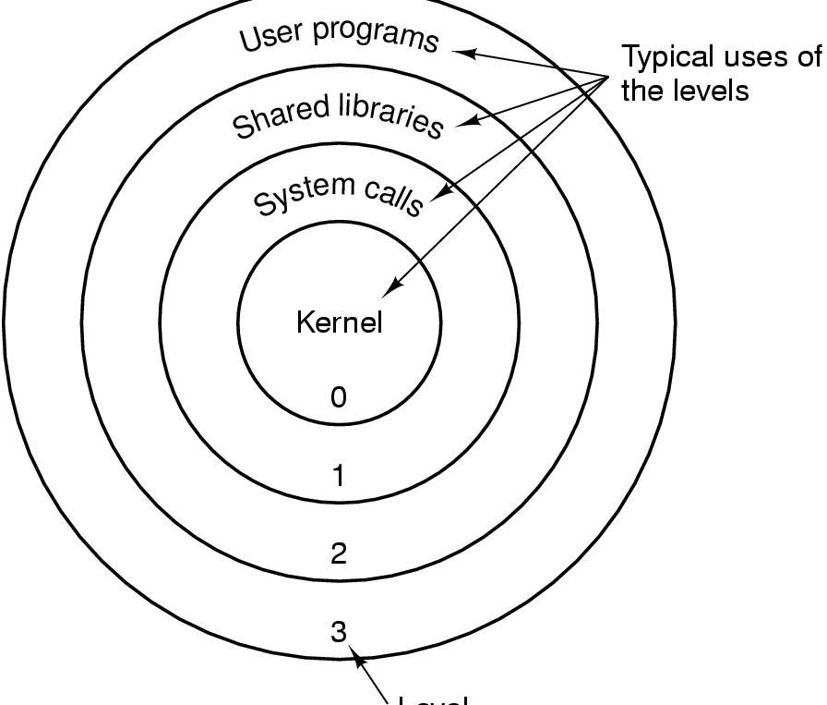
Segmentation with Paging: Pentium (5)
Level
Protection on the Pentium
<number>/73

Slide 59
Summary
Review
Design Issues for paging systems
Implementation Issues
Segmentation
<number>/73

